Slide 1
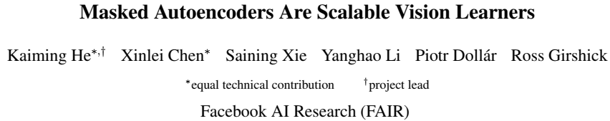
2021.11.14 程志华

Slide 2
MAE
what makes masked autoencoding different between vision and language?
Architectures were different.
This architectural gap, however, has been addressed with the introduction of Vision Transformers (ViT).
Information density.
Images are natural signals with heavy spatial redundancy.
The autoencoder’s decoder.
While in BERT the decoder can be trivial, but for images, the decoder design plays a key role in determining the semantic level of the learned latent representations.
two designs:
Asymmetric encoder-decoder architecture, with an encoder that operates only on the visible subset of patches (without mask tokens), along with a lightweight decoder that reconstructs the original image from the latent representation and mask tokens.
Masking a high proportion of the input image, e.g., 75%, yields a nontrivial and meaningful self-supervisory task.

Slide 3
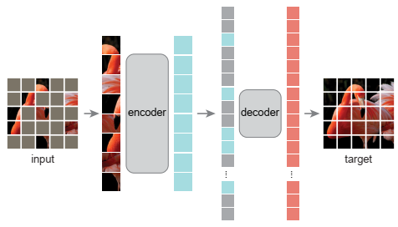
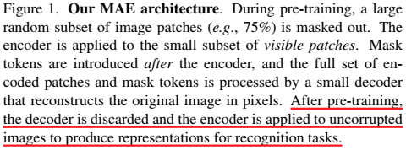
MAE
Method
The default decoder has <10% computation per token vs. the encoder

Slide 4
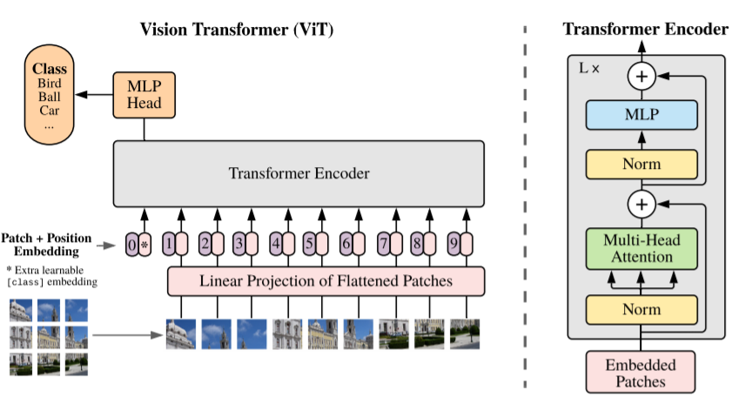
MAE
Method
encoder
Encoder embeds patches by a linear projection with added positional embeddings.
Then processes the resulting set via a series of Transformer blocks.
Masked patches are removed; no mask tokens are used. This allows us to train very large encoders with only a fraction of compute and memory.

Slide 5
MAE
Method
decoder
reconstruction target
Input to the decoder is the full set of tokens: (i) encoded visible patches, (ii) mask tokens.
Add positional embeddings to all tokens in this full set.
The decoder has another series of Transformer blocks.
The last layer of the decoder is a linear projection whose number of output channels equals the number of pixel values in a patch. The decoder’s output is reshaped to form a reconstructed image.
The default decoder has <10% computation per token vs. the encoder.
Mean squared error (MSE) between the reconstructed and original images in the pixel space.
Compute the loss only on masked patches.
Using normalized pixels as the reconstruction target improves representation quality in our experiments.

Slide 6
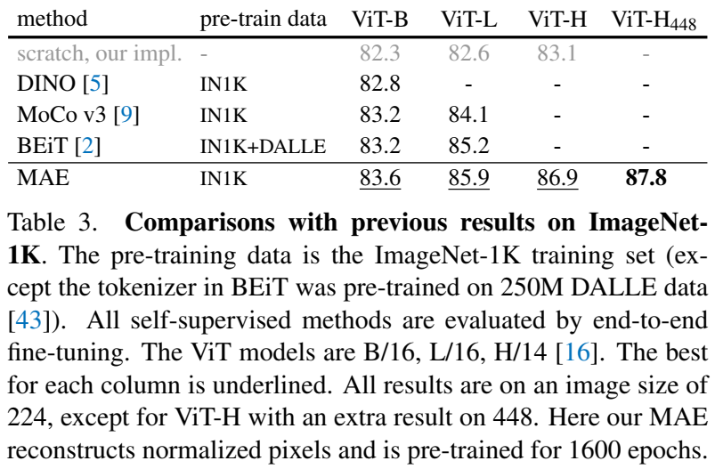
MAE
Experiments
Comparisons with self-supervised methods

Slide 7
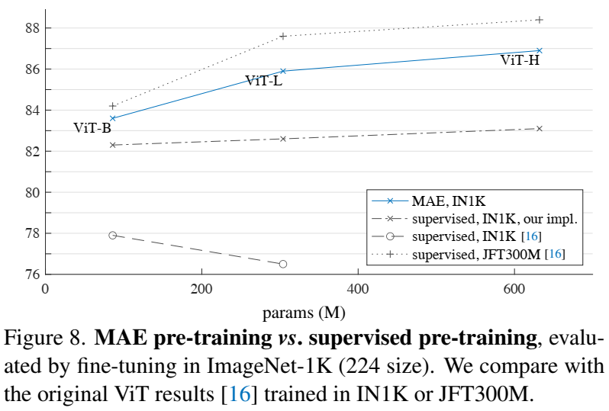
MAE
Experiments
Comparisons with supervised methods

Slide 8
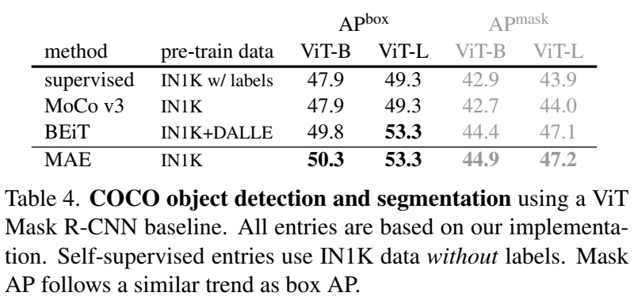
MAE
Experiments
Object detection and segmentation

Slide 9
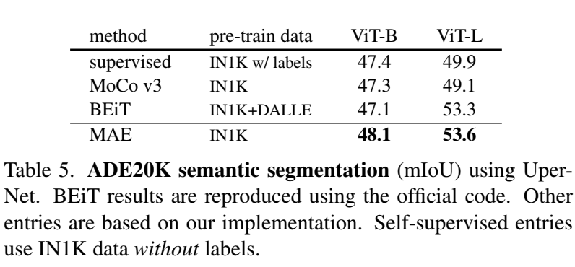
MAE
Experiments
Semantic segmentation

Slide 10
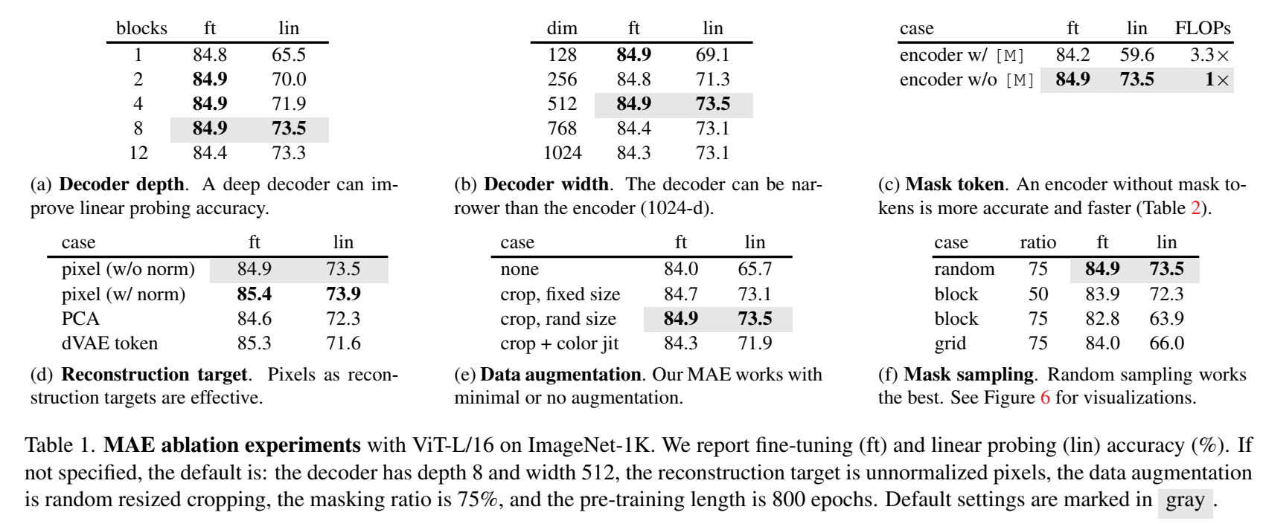
MAE
Experiments
Ablation study

Slide 11
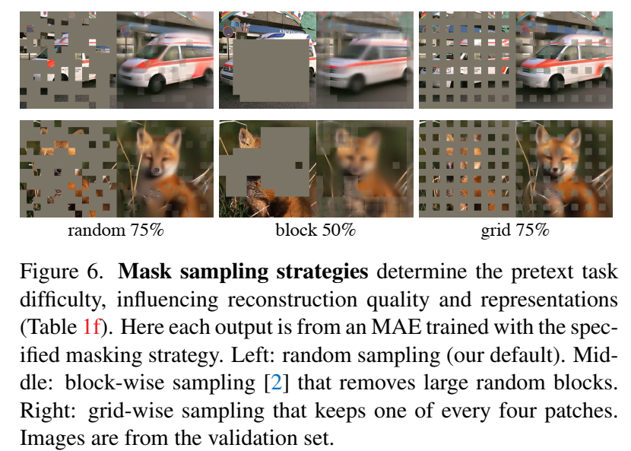
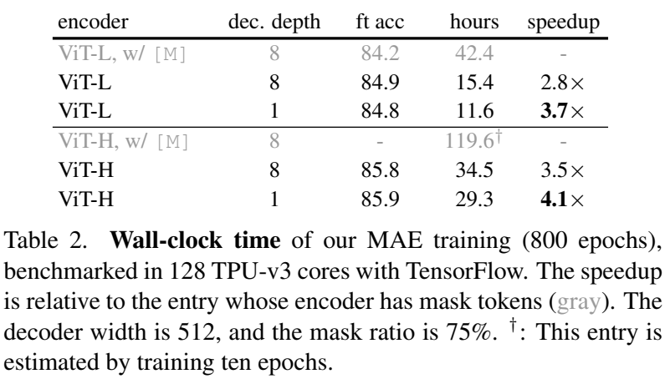
MAE
Experiments
Ablation study

Slide 12
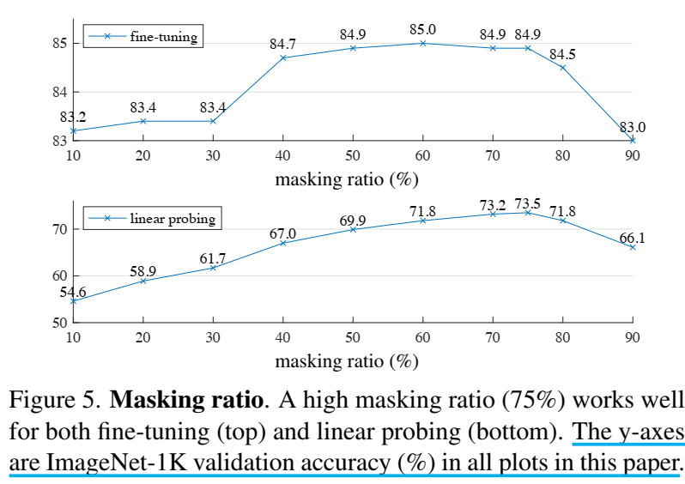
MAE
Experiments
Ablation study

